Slide 1
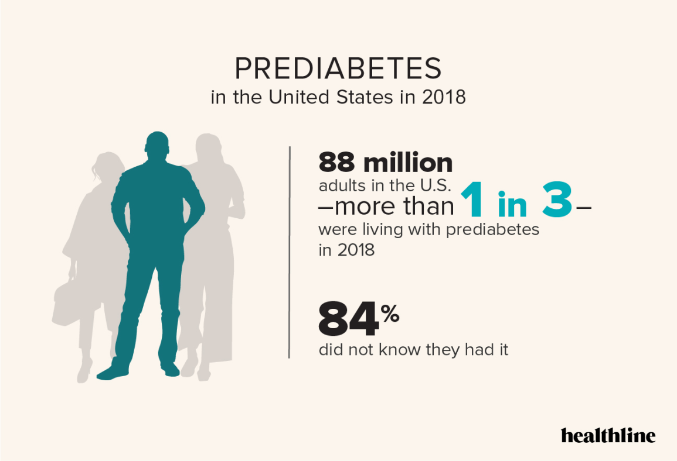
Predicting Diabetes Risk through Data Mining
ALY 6040 – Data Mining Application
Prof. Justin Grosz
Submitted By:
Jainam Patel
Smitkumar Dholiya
Dushang Shah
05/15/2025

Slide 2
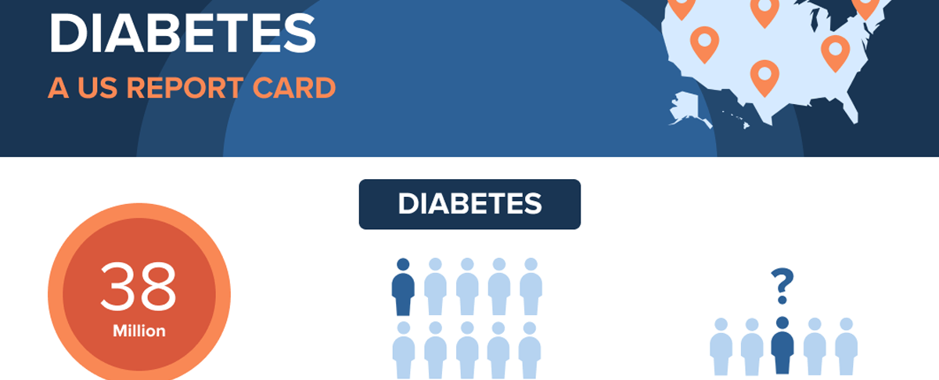
Real-World Problem
Problem Statement:
Diabetes is a growing public health concern. Early prediction can prevent serious complications and reduce healthcare costs.
In 2021, 38.4 million Americans, or 11.6% of the population, had diabetes.
About 352,000 Americans under age 20 are estimated to have diagnosed diabetes, approximately 0.35% of that population.
Why Data Mining?
Traditional statistical methods fall short in capturing complex, non-linear interactions.
Data mining uncovers hidden patterns crucial for early diagnosis.

Slide 3
Dataset Overview
Dataset: Healthcare Diabetes Dataset
Source: Kaggle (CSV format)
Key Variables: Glucose, BMI, Blood Pressure, Insulin, Age, Outcome (Diabetes: Yes/No)
Why This Dataset?
Contains diverse health indicators ideal for modeling and visualization.
Offers real-world application for diabetes risk prediction.

Slide 4
Data Cleaning
Problems Identified:
Invalid zero entries in medical fields (e.g., glucose, insulin)
Unusable ID column
Missing values not explicitly marked
Cleaning Steps:
Replaced 0s with median values to maintain dataset integrity
Removed ‘ID’ column since it is only for indexing

Slide 5
Methodology
Steps Taken:
Exploratory Data Analysis (EDA)
Correlation Analysis (Pearson)
Multicollinearity Check (VIF)
Modeling: Logistic Regression and Decision Tree
Evaluation: Confusion Matrix, ROC, AUC
Tools Used: Python (Pandas, Seaborn, scikit-learn)

Slide 6
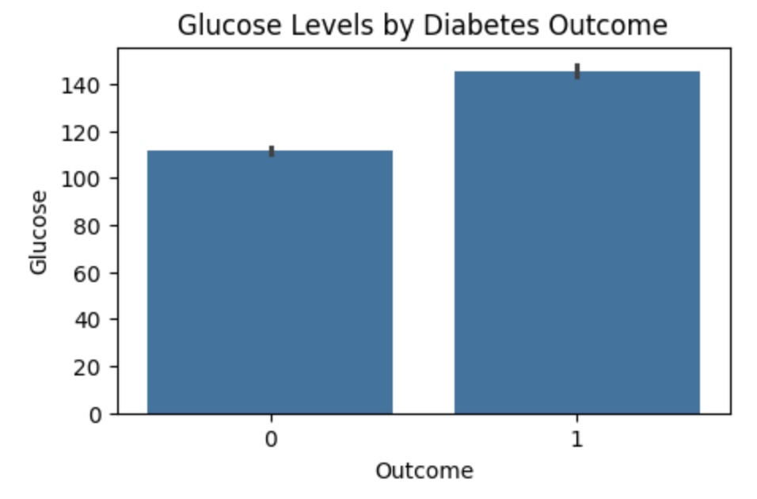
Key Visual Insights
Glucose vs. Diabetes Outcome:
Higher glucose → Higher diabetes risk
It indicates that those with diabetes generally have higher glucose levels compared to those without diabetes.

Slide 7
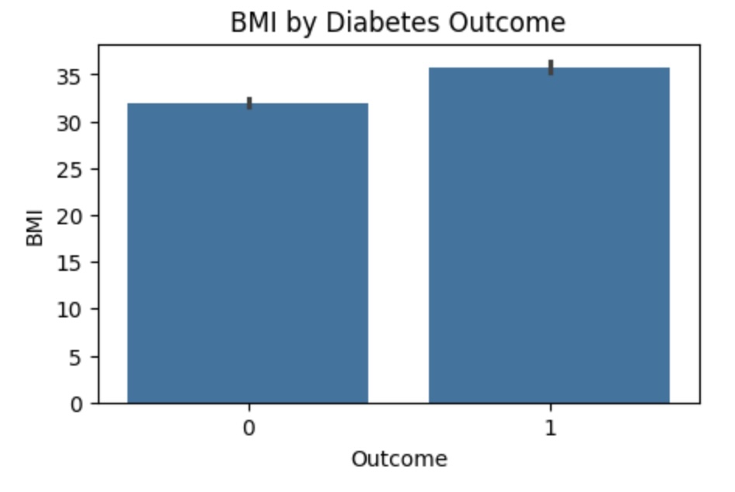
BMI vs. Outcome:
Obesity strongly correlates with diabetes
Optimal BMI: 25
Overweight: 25<BMI<=30
Class 1 Obesity: BMI>30

Slide 8
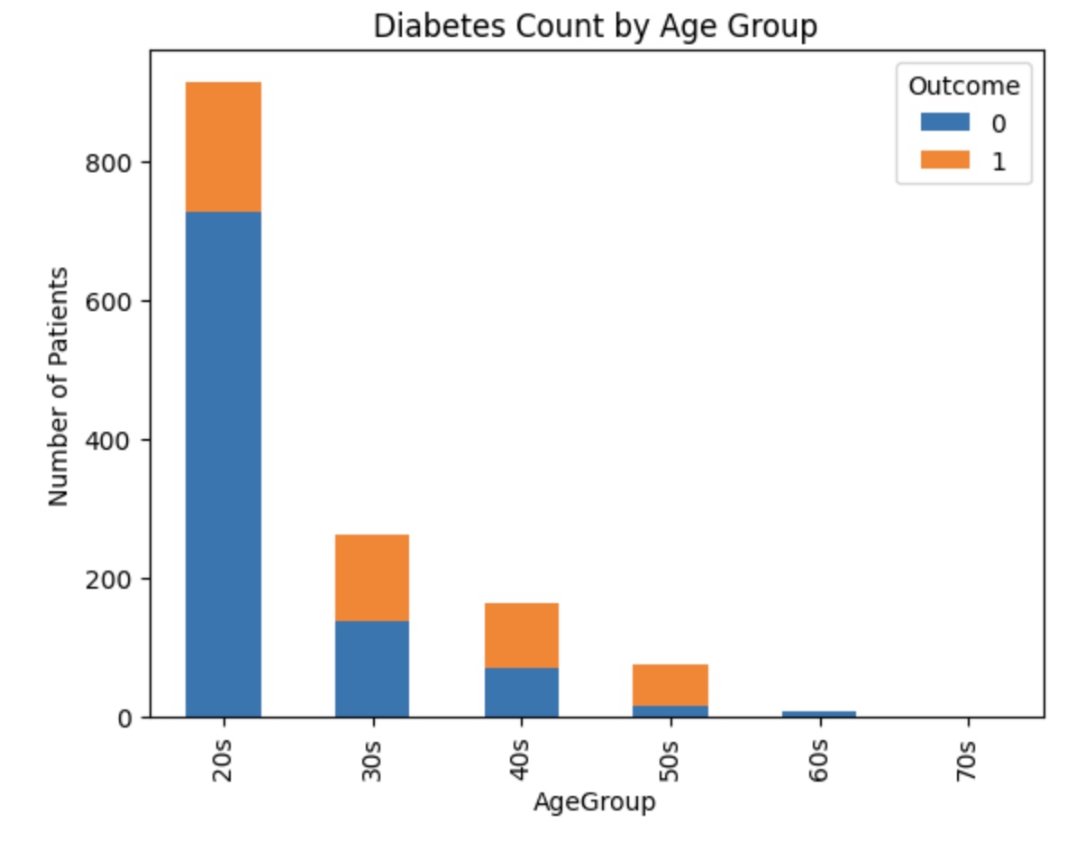
Age vs. Outcome: Risk increases significantly after age 40
Less diabetes cases during 20’s and 30’s
Half of the population suffer from diabetes from 40’s onwards

Slide 9
Model Performance
Decision Tree captures non-linear patterns better and has fewer false negatives.
Model/Results | Accuracy | Precision | Recall | F1-Score | ROC
Logistic Regression | 0.76 | 0.63 | 0.68 | 0.65 | 0.83
Decision Tree | 0.83 | 0.72 | 0.83 | 0.77 | 0.90

Slide 10
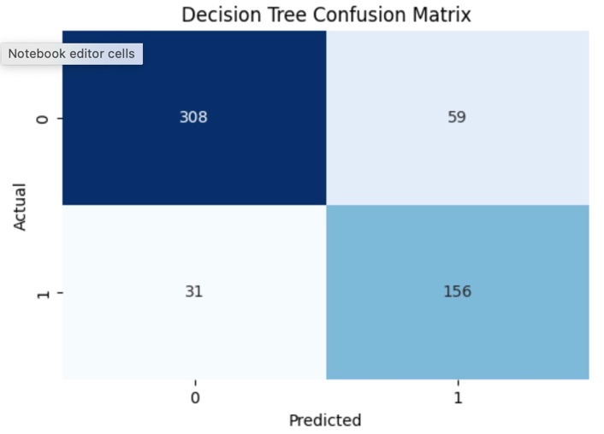
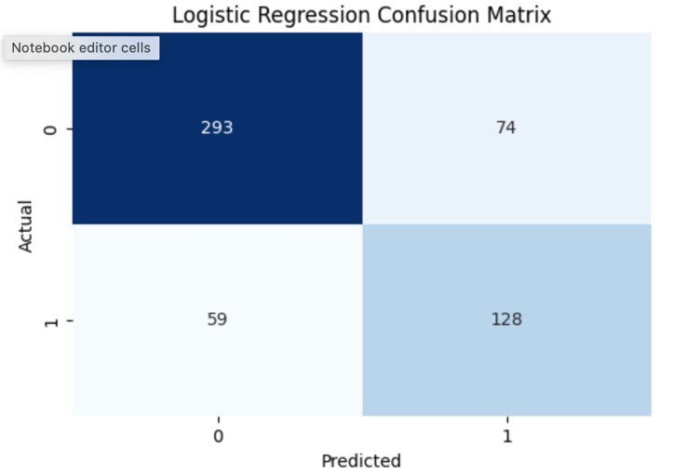
Confusion Matrix Insights
Decision Tree:
True Positives: 156
False Negatives: 31
Logistic Regression:
True Positives: 128
False Negatives: 59
Impact: Decision Tree is safer for patient diagnosis due to fewer missed cases.

Slide 11
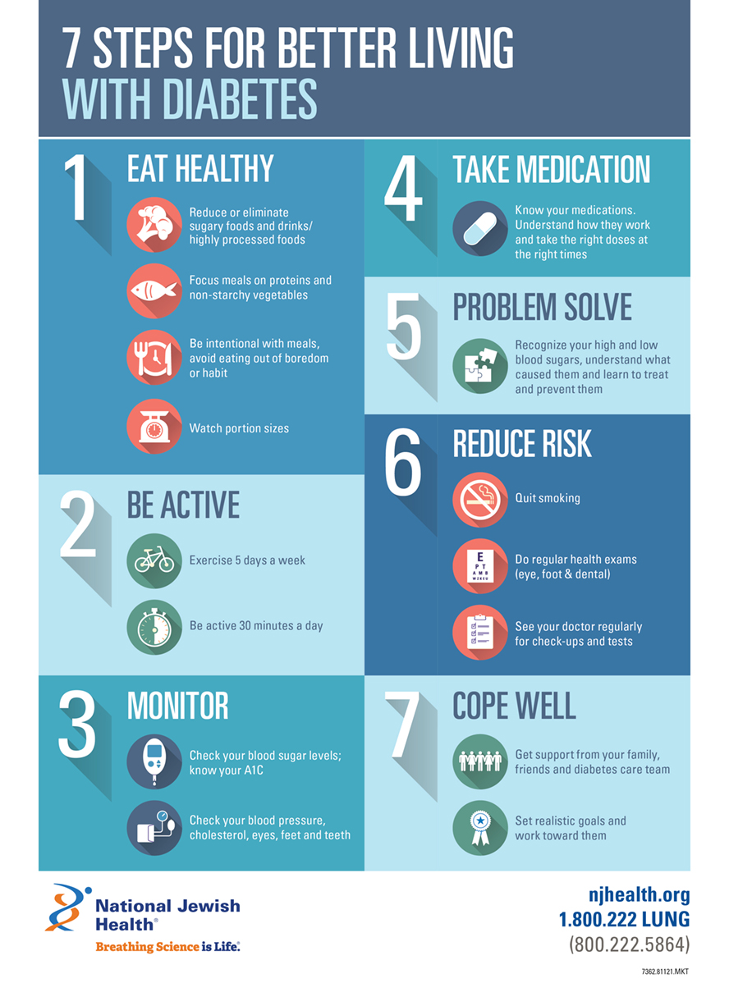
Recommendations and Insights
Glucose as a Dominant Indicator with correlation of 0.5
Age as a Progressive Factor with 50% increase in prevalence
Prioritize Glucose and BMI Monitoring
Incorporate Genetic and Metabolic Data
Explore Lifestyle Factors

